Slide 1

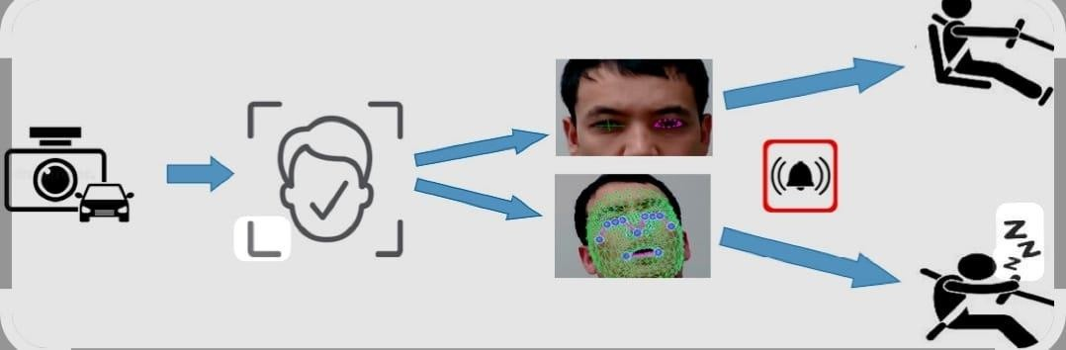

AI - BASED HYBRID DRIVER DROWSINESS AND SAFETY
MONITORING SYSTEM
1

Slide 2

Driver drowsiness is one of the major causes of road accidents world wide .
When a driver becomes tired or sleepy, reaction time slows and attention decreases
Early detection of driver fatigue is important to improve road safety.
Real-time drowsiness detection systems use computer vision and machine learning
.
A camera monitors facial features such as eye blinking, eye closure, and yawning.
Tools like OpenCV and Dlib detect facial landmarks and eye movements.
Machine learning models classify the driver as alert or drowsy and send an alert if drowsiness is detected.
INTRODUCTION

Slide 3


PROBLEM STATEMENTS
Driver drowsiness is a major cause of road accidents worldwi de.
When drivers become tired or sleepy, their reaction time slows and concentration decreases.
Many accidents occur because drivers are unaware of their drowsy condition while driving.
Traditional safety measures cannot effectively detect driver fatigue in real time.
Therefore, there is a need for an automated system that can
monitor the driver continuously

Slide 4
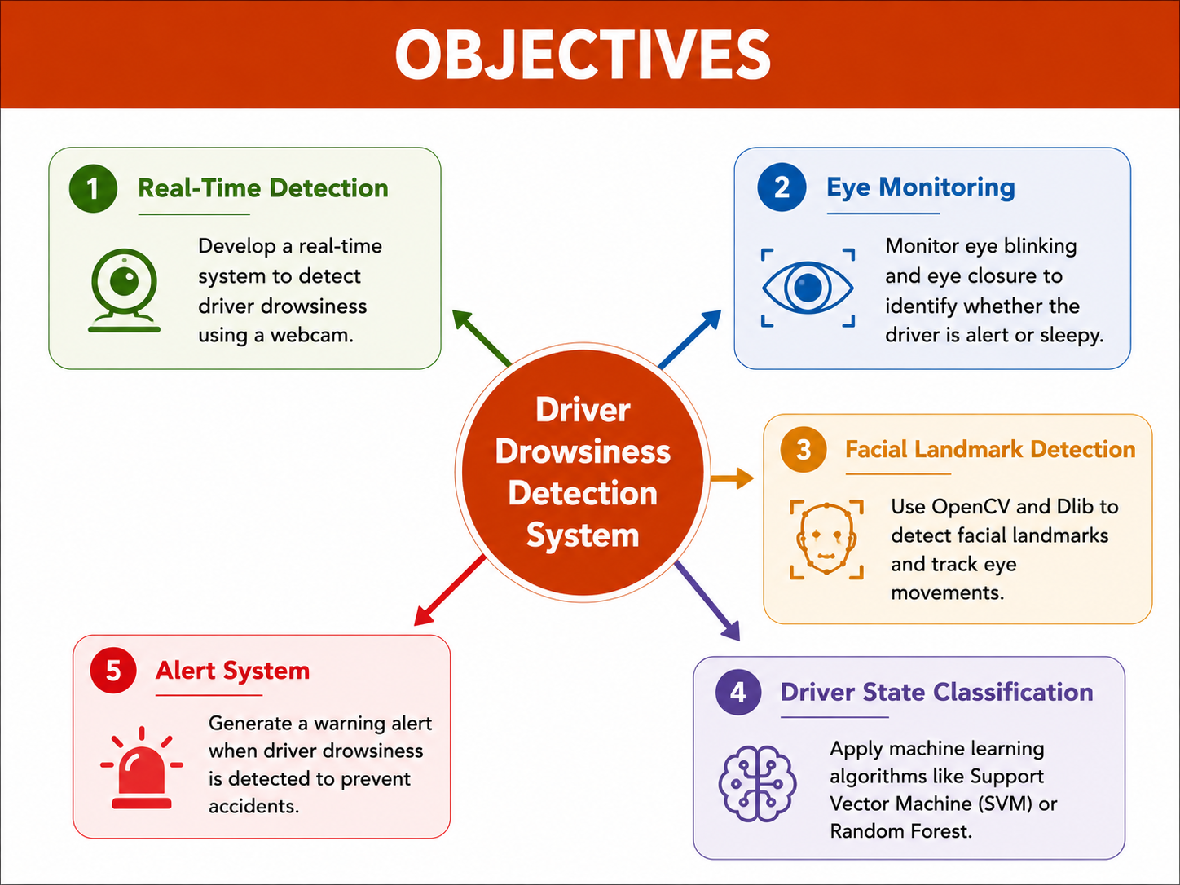

Slide 5

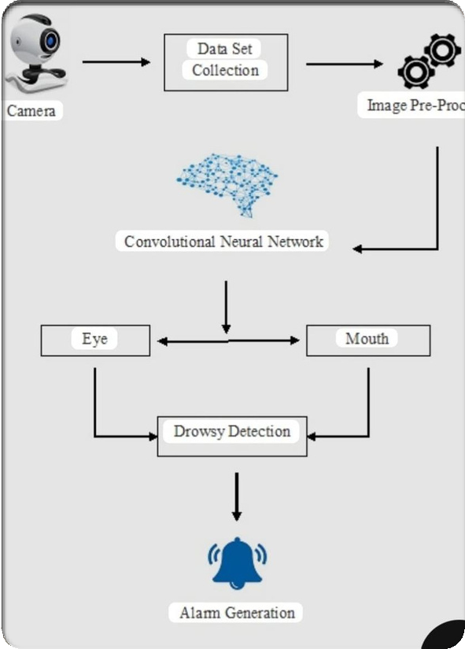
SOFTWARE TOOLS
Python
Used to write the program for the detection system.
Visual Studio Code
Code editor used
OPEN CV
Used for image processing and capturing video from the webcam.
Dlib
Used for detecting facial landmarks such as eyes, nose, and mouth.
NumPy
Used for mathematical calculations and array ope rations.

Slide 6

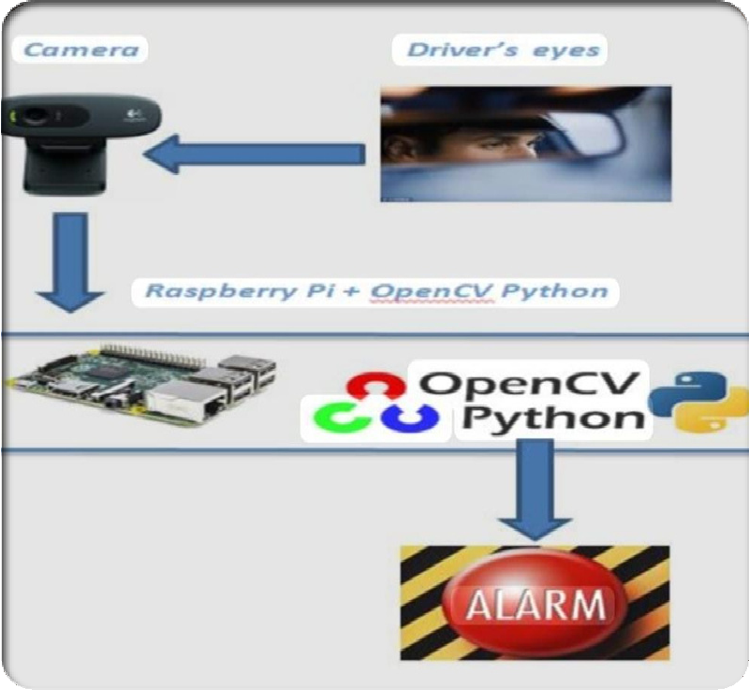
HARDWARE TOOLS
Camera/Webcam::
Capture driver’s face in real time.
Raspberry Pi / Laptop: Processes video and runs detection algorithm.
Buzzer / Alarm:
Alerts driver when drowsiness is detected.
Power Supply:
Provides power to all hardware components.

Slide 7
➢
The system analyzes different facial visual features to detect drowsiness.
Eye Blinking Rate
Frequent blinking may indicate fatigue. Eye Aspect Ratio (EAR)
Measures eye openness to detect eye closure.
Yawning Detection
Detects when the driver opens their mouth widely. Head Position / Head Tilt
Detects if the driver’s head is dropping due to sleepiness.
Facial Landmarks
68 points on the face detected using Dlib.
Visual features
used

Slide 8
Improves Road Safety
The system helps prevent accidents by detecting driver drowsiness early and alerting the driver.
Real-Time Monitoring
The driver’s facial features are continuously monitered using computer vision tools like OpenCV.
•
Non-Intrusive System
It does not require the driver to wear any sensors or special devices.
ADVANTAGES
•
Low Cost and Easy Implementation
The system can be implemented using a webcam , a computer, and software libraries such asDlib.
5️⃣ Fast Detection
The system can detect eye closure and yawning quickly and provide immediate alert .
8
Sample Footer Text

Slide 9
Future scope
Integration with Vehicles
The system can be integrated directly into modern vehicles for automatic driver
m➢onitoring.
Night Vision Detection
Using infrared cameras to detect drowsiness even in low light or night driving conditions
➢Mobile Application Integration
T➢he system can send alerts to a mobilephone or emergency contact.
Health Monitoring
Future systems canincludesensorstomonitor the driver’s health conditions such as stress or fatigue.
Smart Vehicle Control
The vehicle could automatically reduce speed or stop safely if severe drowsiness is detected.

Slide 10
CONCLUSION
The system detects driver drowsiness using facial features. Computer vision tools analyze eye blinking and yawning.
An alert is generated when drowsiness is detected.
The system helps improve road safety and prevent accidents. Future improvements can make the system more advanced And reliable.

